Slide 1
Building and Managing High Performance Clusters(HPC)
Project Completion Report – Team black

Slide 2
Agenda
Introduction
Project milestones
Setup
Testing
Learnings
Contributions

Slide 3
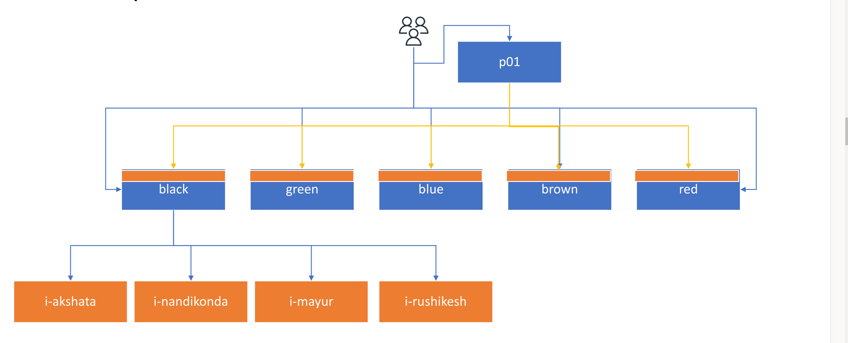
Introduction

Slide 4
Timeline
1
Preparation and Develop a project plan
(3rd March)
2
Configure, Build and Test Slurm Controller
(3rd March )
3
Configure and Build Slurm worker nodes and integrate them to the team cluster
(April 12th)
4
5
Provision accounts on Slurm
(April 19th)
Submit parallel jobs by submitting multiple jobs using array and chain submission
April 19th
7
6
Test the integrated system by submitting jobs to the cluster
April 19th
Setup and test QOS
April 19th

Slide 5
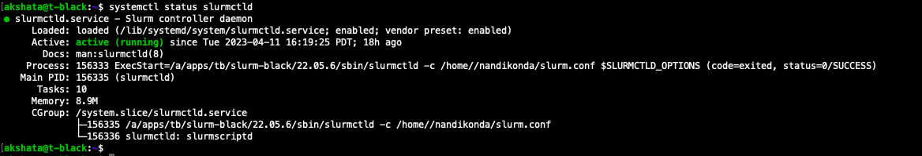
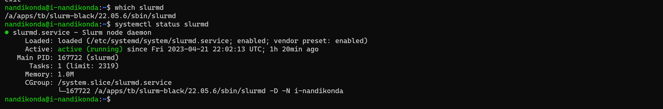
Install and configure Slurm
Install and start the Slurm controller (slurmctld) service in the control node of the cluster(t-black)
Install and start the slurm demoan (slurmd) service in the worker nodes(i-nandikonda, i-mayur,i-rushikesh, i-akshata)
Notes:
1) Start by installing slurm at a team-black in shared efs storage /a
2) Slurmctld service has be updated to use the slurm installed at the above location
3) Update the slurm.conf file and provide the cluster name as black , slutmctld host as t-black and provide the compute node details
4)Then start the slurmctld service in the team instance and then check the status of the slurmctld service.
5) In all the individual instances, update the slurmd service to use the slurm installed at the team-clack directory
6)Once slurmd.service is updated, start the slurmd service and check the status of the service

Slide 6
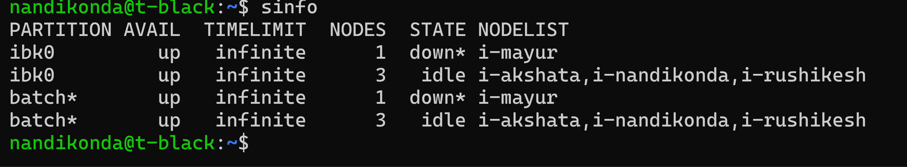
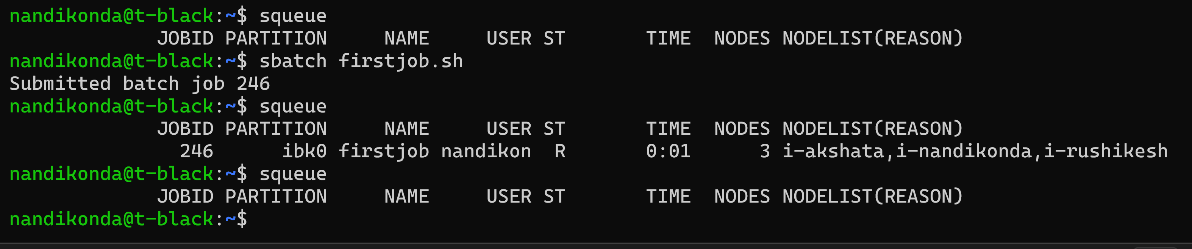
Integrate controller and worker nodes
Check the slurm state by using the sinfo command
We can even verify the integration by submitting a job in the Slurm controller
Notes:
1)Verify the slurm state, by running sinfo command in the control node, from the output we can see the cluster black has two partitions namely ibk0 and batch
2) Then to test if the slurm controller and worker nodes are integrated successfully we have created a simple bash script and have run it using the sbatch command , Sbatch created job with id 246 and three nodes are running the job.

Slide 7
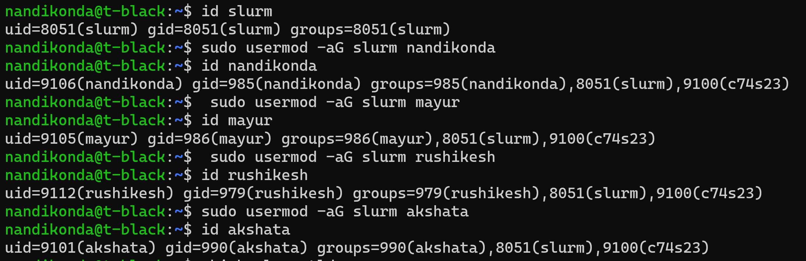

Account provisions
Grant the necessary permissions to each user account of the team by adding them to the appropriate groups
Edited the Slurm configuration files to specify the user accounts and their associated permissions.
Notes:
1)Grant the necessary permissions to each user account of the team by adding them to the appropriate groups. I have added users to the "slurm" group so they can submit jobs to Slurm.
2) Edited the Slurm configuration files to specify the user accounts of our team members are accounting storage users. The configuration files for the slurm for team black are located in the "/a/apps/tb/slurm-black/22.05.6/etc/slurm.conf" directory.
3)Once done with the changes, we have restarted the slurm controller and slurmd in the worker nodes to reflect the changes.

Slide 8
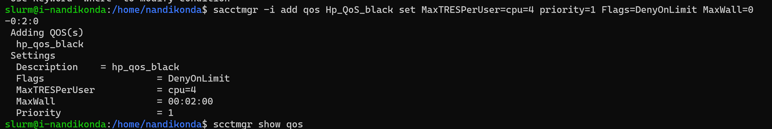
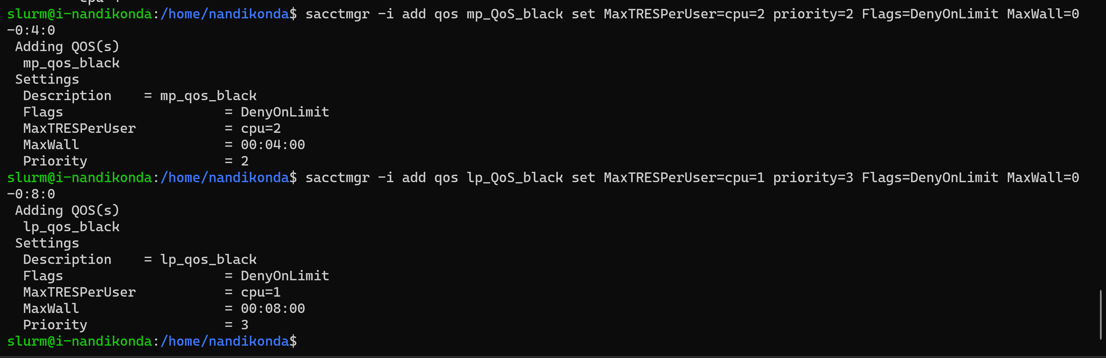
Set up QOS
Create QOS groups
Notes:
QOS stands for Quality of Service. QOS allows administrators to define various levels of service quality for different users or groups of users. The QOS feature in SLURM enables administrators to prioritize jobs based on their importance or resource requirements.
We have set up three qos groups, hp_qos_black , mp_qos_black and lp_qos_black with different configurations for running the high priority, low priority and medium priority jobs.
For example, hq_qos_black, has the max CPU usage as 4 , max time as 2 min and Highest priority to run the jobs

Slide 9
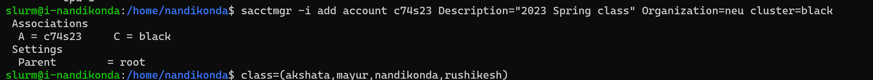
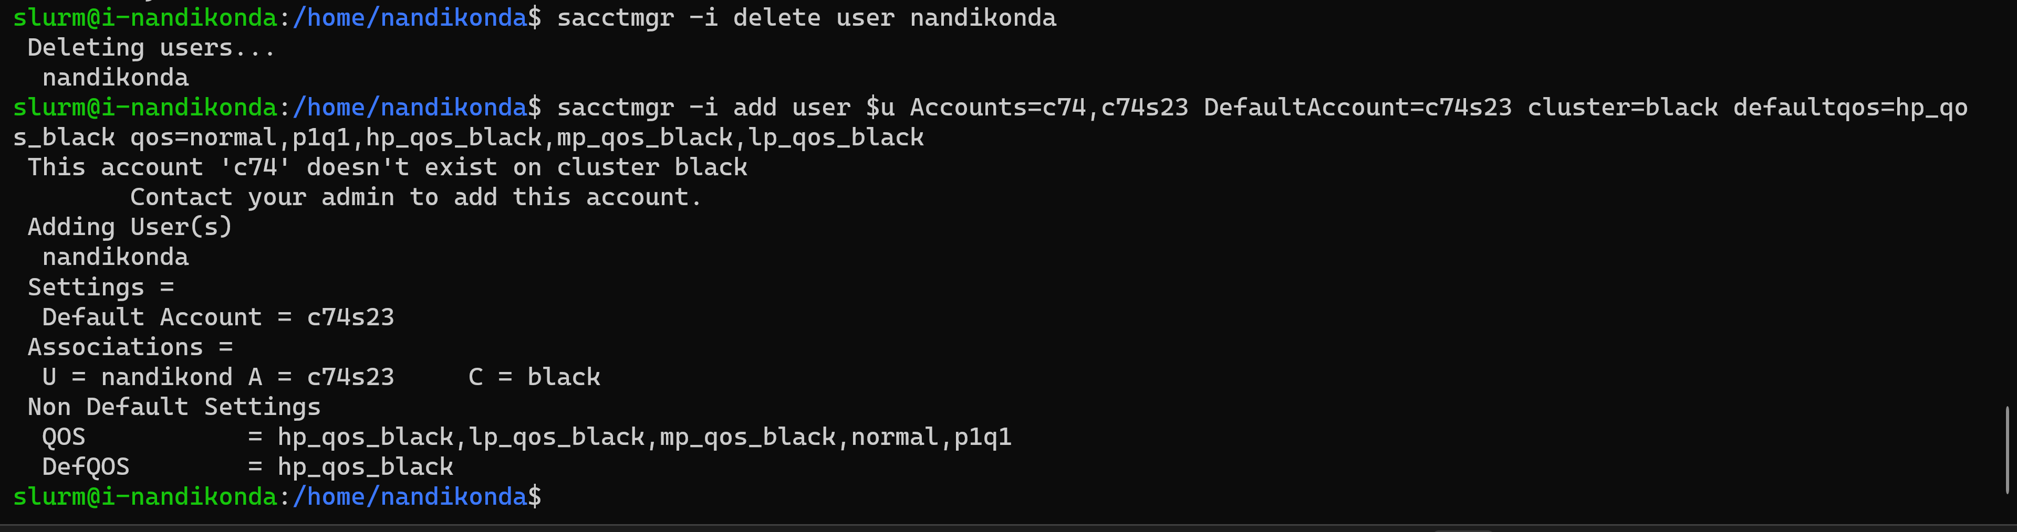
Set up QOS
Have added an account to the Slurm accounting system using the below command
Associate the user accounts with slurm account and qos that have been created in the prior steps
Notes:
Add a new account c74s23 to the Slurm accounting systems of the cluster black
Associate the individual user accounts to the slurm account and qos created in the prior steps, each user will be associated to all the qos related to black cluser that are created so that they can run the jobs in which evet the qos they want , but each user will have different default qos.

Slide 10
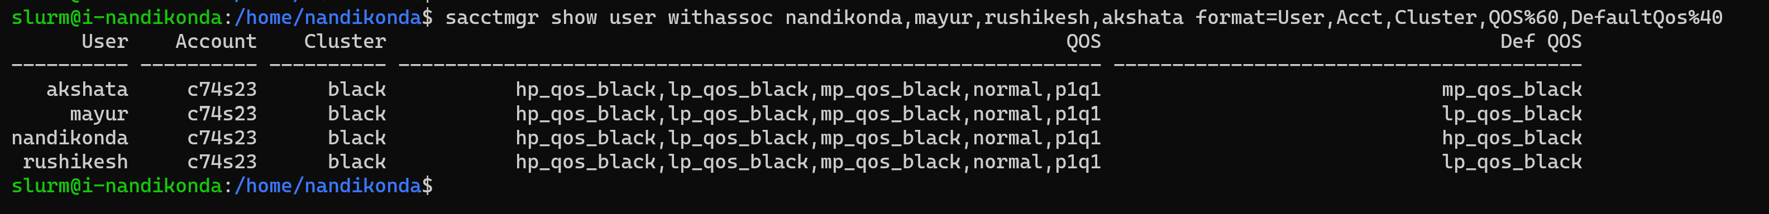
Set up QOS
Check the configuration of newly created QOS
Check the user associations for the individual accounts of the team members
Notes:
From the first screenshots, we can confirm that three new qos have been successfully added and each have different configuration with respect to number of CPUS, Priority and max time
From the second screeshot, we can confirm that each individual accounts have been associated with c74s23 account and QOS related to cluser clack, but they have different default QOS setup

Slide 11
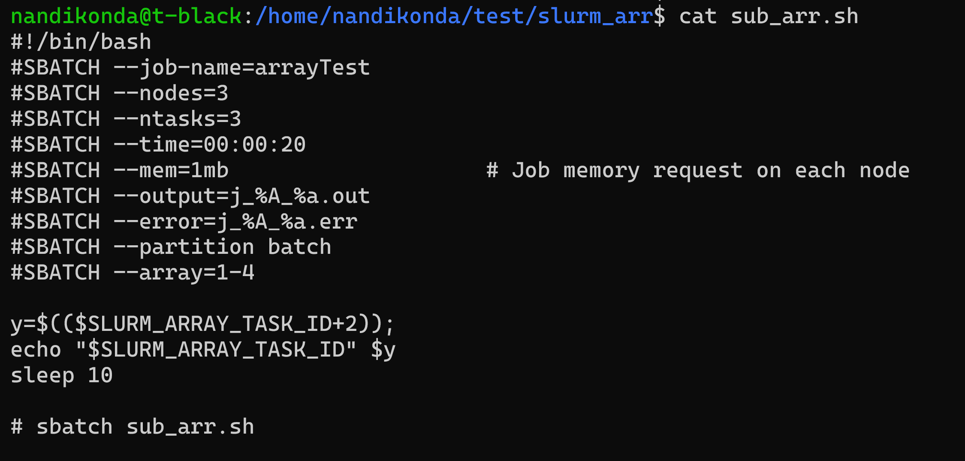
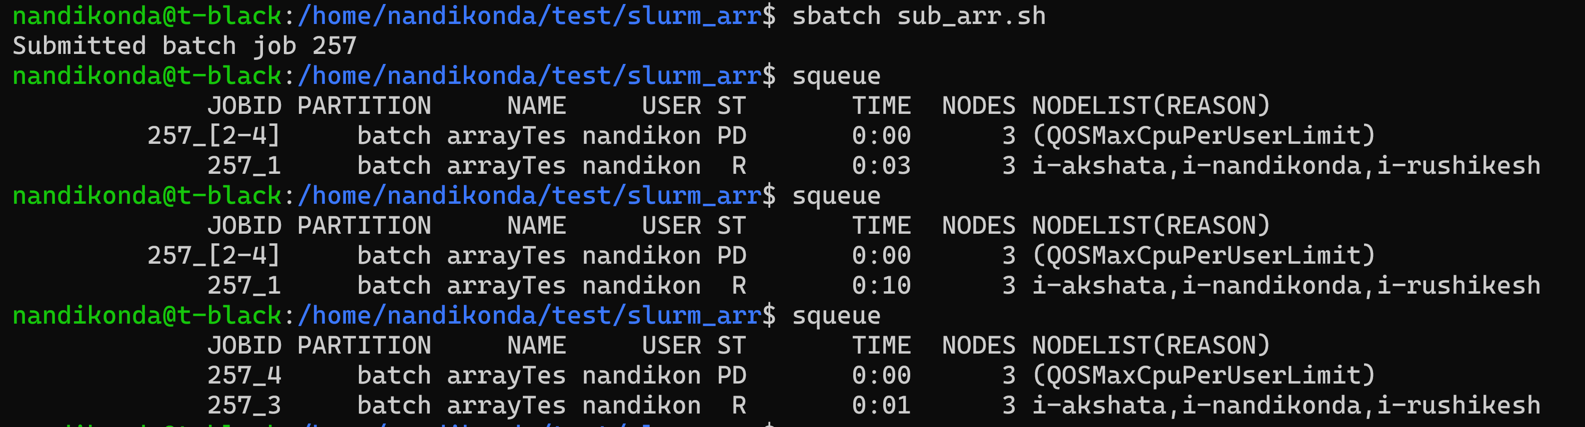
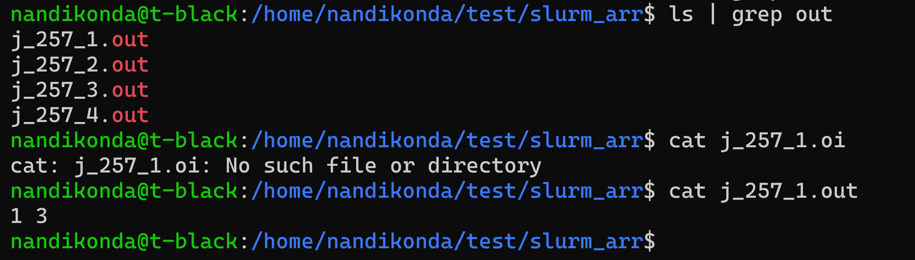
Testing – Array Job Submission
Created a bash script to run the array job submission
Submit the job using sbatch command
Notes:
This script submits an array job to the Slurm workload manager with 3 tasks, each running on 3 nodes and requesting 1MB memory. The job name is "arrayTest", and the output and error logs are stored in separate files with the job ID and array ID
Submit the job using sbatch command, job with id 157 has been created and the available compute nodes have picked up the job and it can be monitored using the squeue command. The standard output for each task in the array will be saved in individual files as provided above.

Slide 12
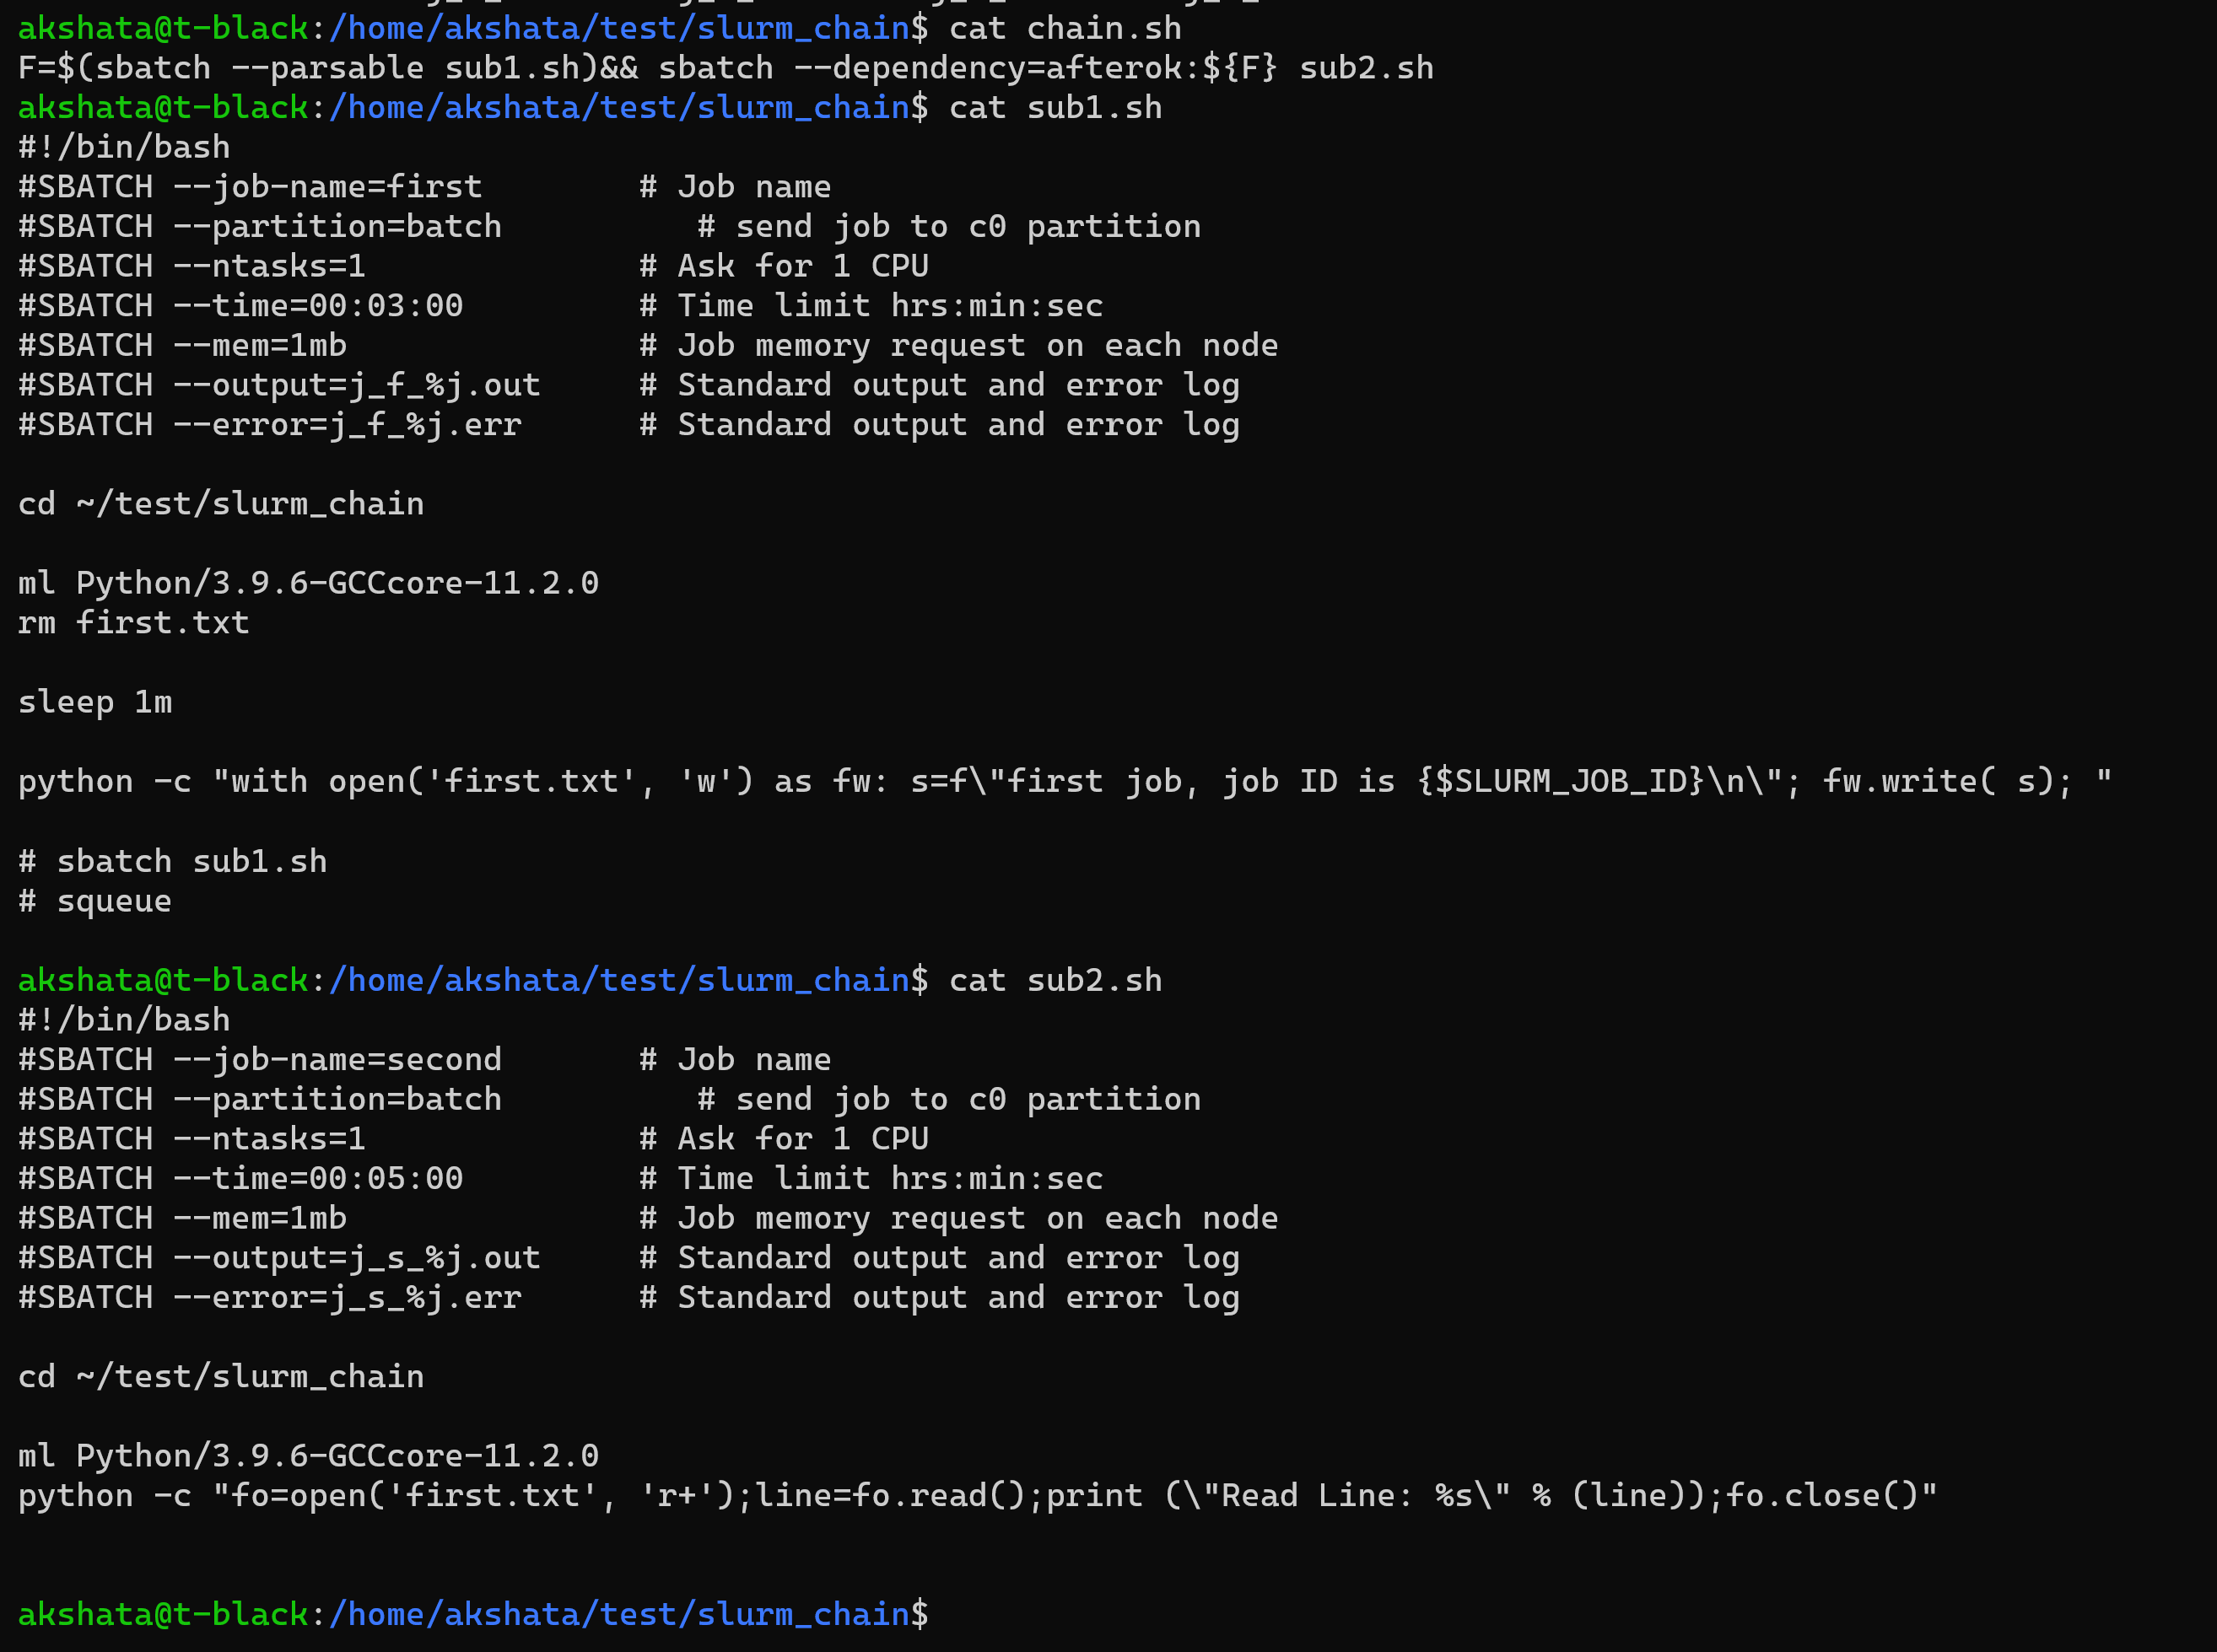
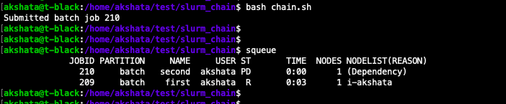
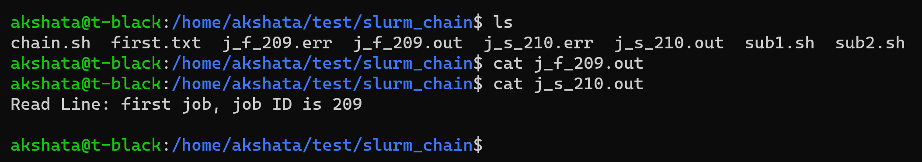
Testing – Chain Submission
Created a bash script to run the chain submission
Submit the job using bash command
Notes:
Created a script file with command to submit two SLURM batch jobs, where the second job (sub2.sh) is dependent on the successful completion of the first job (sub1.sh).
Submit the job using bash command , job with id 210 has been created and the available compute nodes have picked up the job and it can be monitored using the squeue command. The first job would create a text file and then the second job would open the file and copy the contents to a new file created from the job.

Slide 13
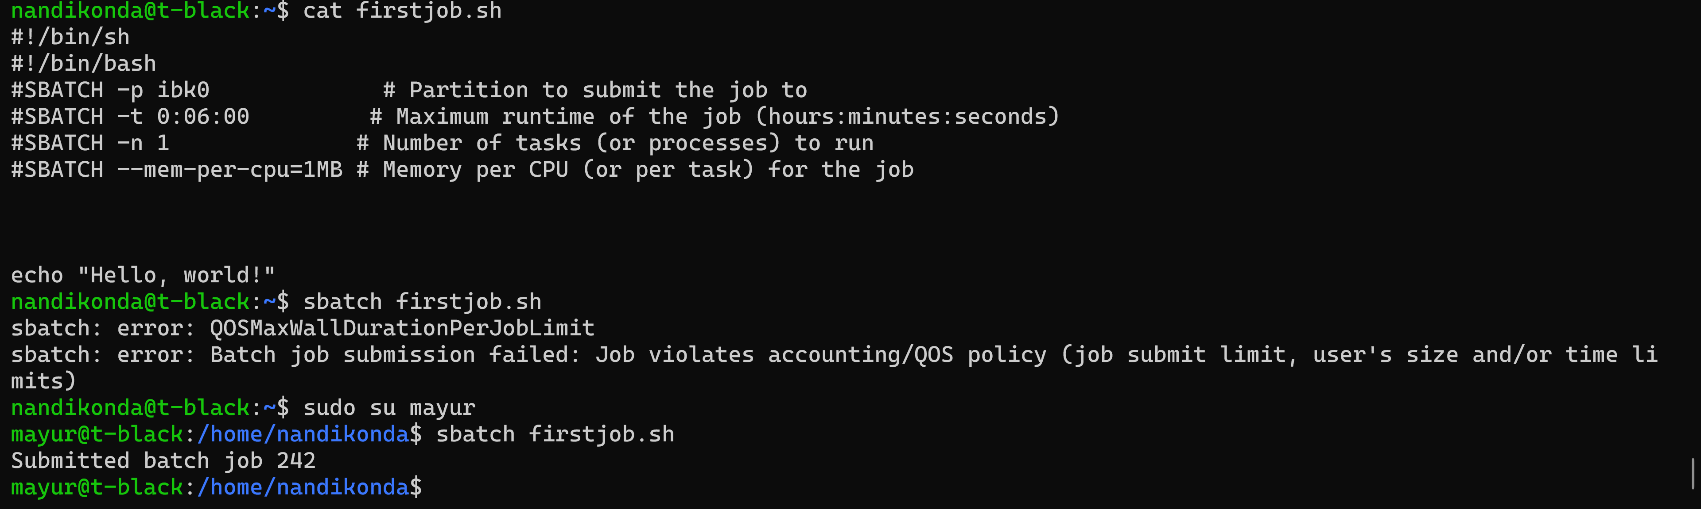
Testing – QOS
Created a bash script to run the chain submission
Submit the job using bash command
Notes:
Created a script with job to run the job with max time required as 6 min and then submit the job using the user account “nandikonda”, job submission failed as nandikonda is assigned to hp_qos_black and limit for the qos is 2 min. Submit the same job with different user “mayur” who is associated with lp_qos_black . Job submission was successful and job successfully executed.

Slide 14
Learnings
Technical Skills
Documentation
Importance of Quality of Service (QoS)
Collaboration

Slide 15
Contributions
Team Tasks
As a team we spent a considerable time sitting and understanding the basic requirements and process for the project.
Srikanth and Akshata
Build and install slurm controller and worker nodes
Documentation
Setting up array and chain jobs
Rushikesh and Mayur
QOS set up
Project Wiki Update
Testing
Presentations

Slide 16

Thank You

